Slide 1
Identifying Tech Debt Hotspots From Version Control Data
Chris Zimmerman
eMoney Advisor, LLC

Slide 2
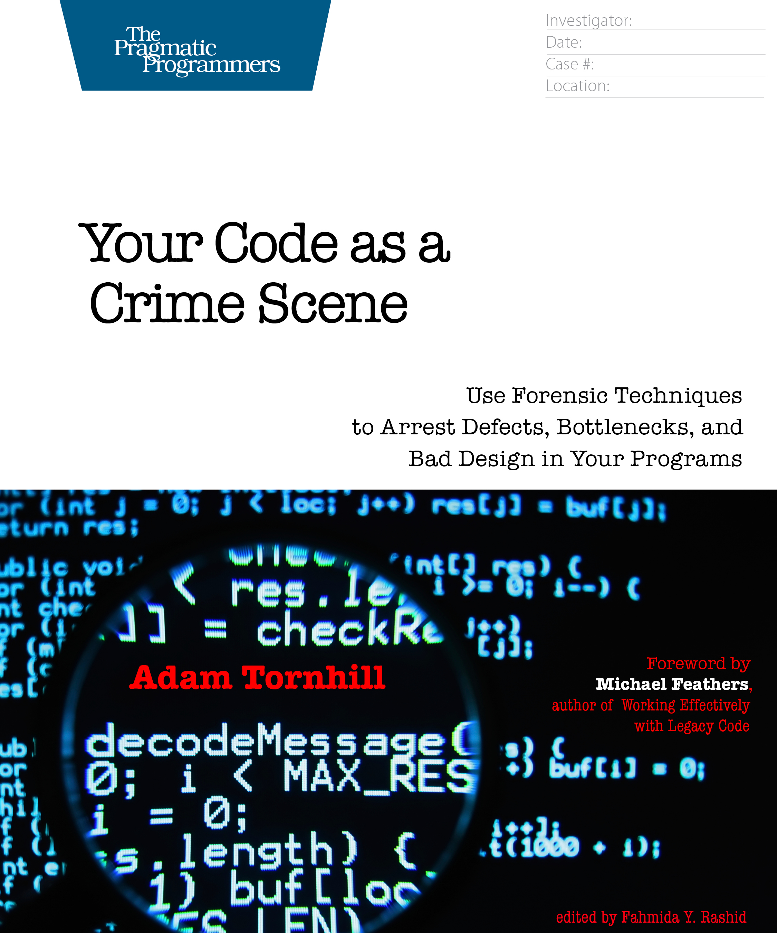
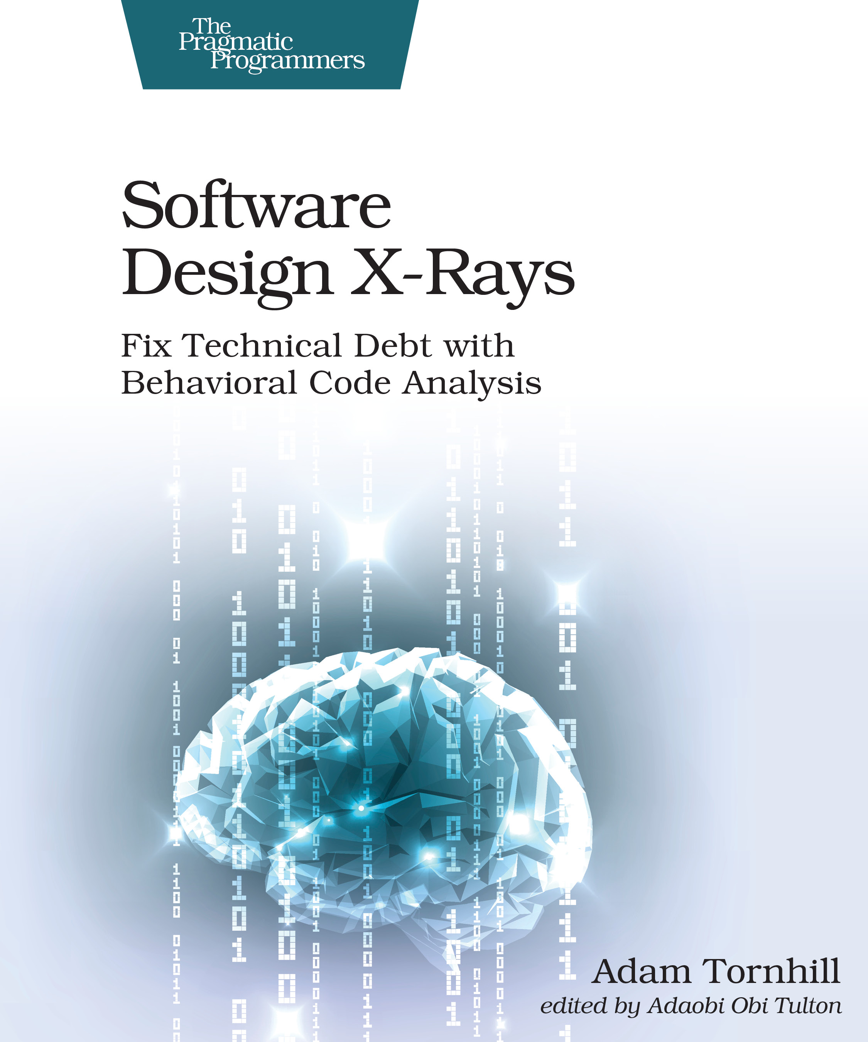

Slide 3
Takeaways
How to prioritize tech debt in your codebase
Some strategies for addressing tech debt
How awesome your version control history is

Slide 4
Technical Debt

Slide 5
Technical Debt
A metaphor for communicating with business
Tradeoffs of releasing earlier vs being able to more easily evolve our software systems
Helps communicate the necessity for refactoring and evolving system architecture

Slide 6
Technical Debt
Code that’s more expensive to maintain than it should be
In other words, we pay an interest rate on it

Slide 7
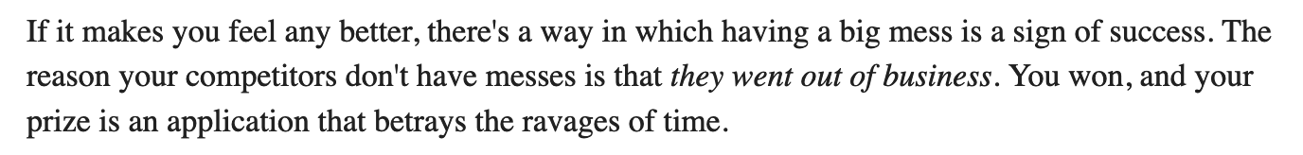
Technical Debt Is Not Always Bad
- Sandi Metz

Slide 8
Not all “bad code” is technical debt

Slide 9
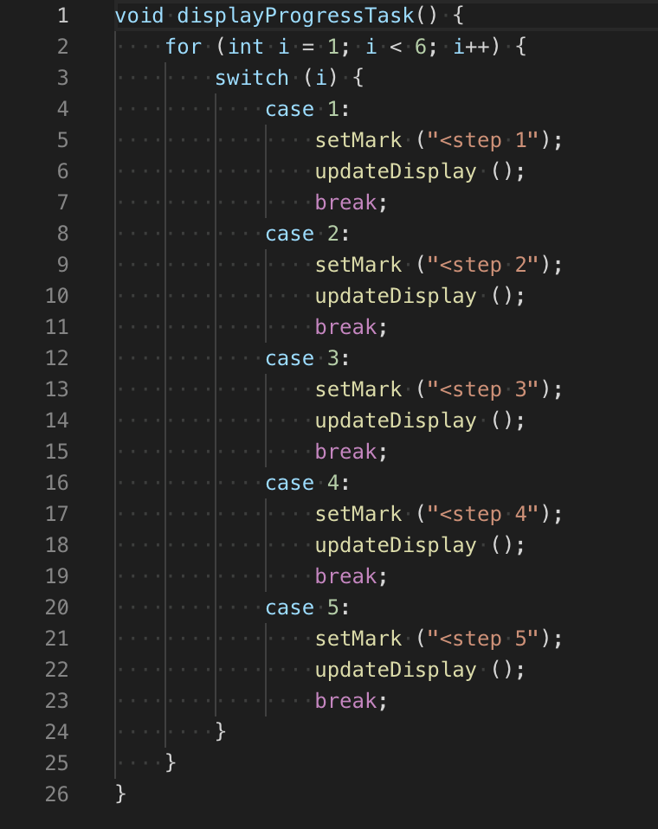

Slide 10
Is it technical debt?

Slide 11
It’s not technical debt unless we have to pay interest on it

Slide 12
Interest is a function of time

Slide 13
Measuring interest rates

Slide 14
“We refactor code that impedes us, not all that offends us.” - Tim Ottinger

Slide 15
How do we measure interest rates?

Slide 16
Two pieces of information

Slide 17
Change Frequency

Slide 18
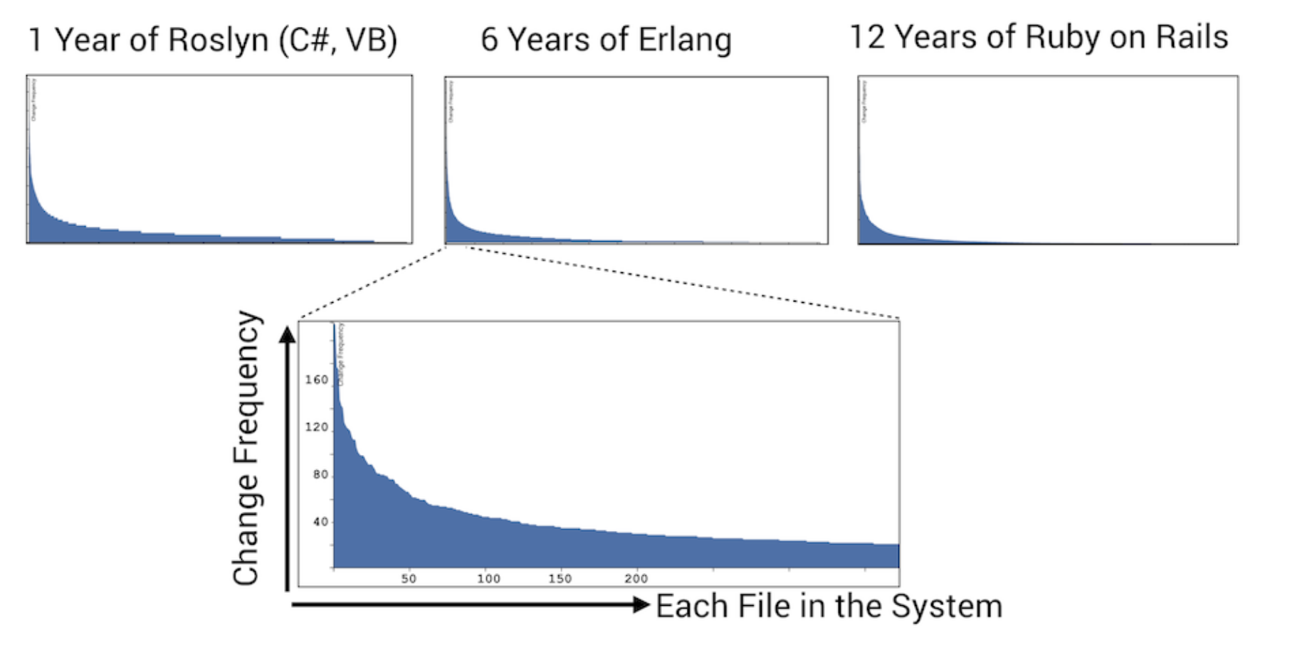

Slide 19
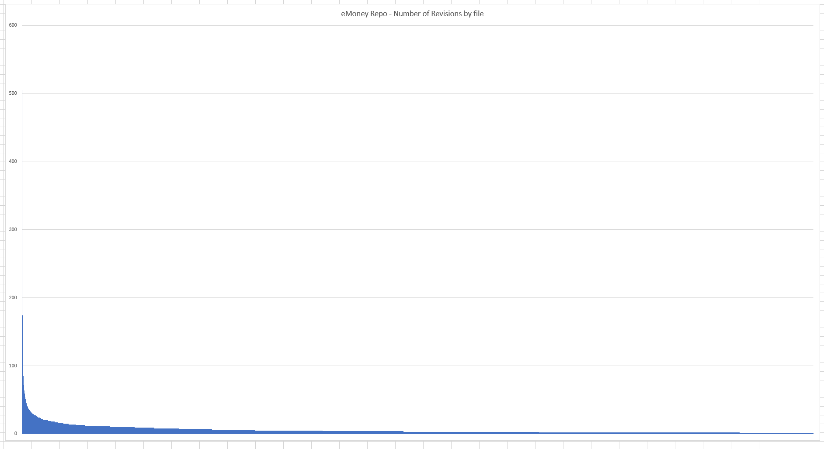
~18 years of eMoney

Slide 20
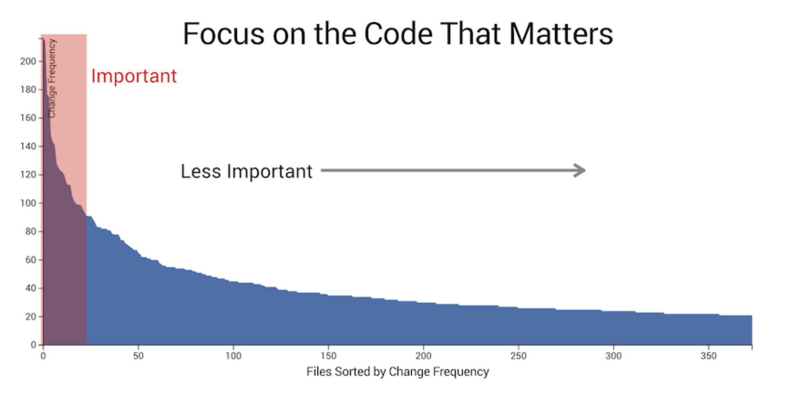

Slide 21
Change frequency alone is not enough
Context is important: Version.txt vs 3,000 line C# class

Slide 22
Code complexity

Slide 23
How to measure code complexity

Slide 24
Lines of code (LOC)

Slide 25
Hotspots

Slide 26
Complicated code you have to work with often

Slide 27
Code with the highest interest rates

Slide 28
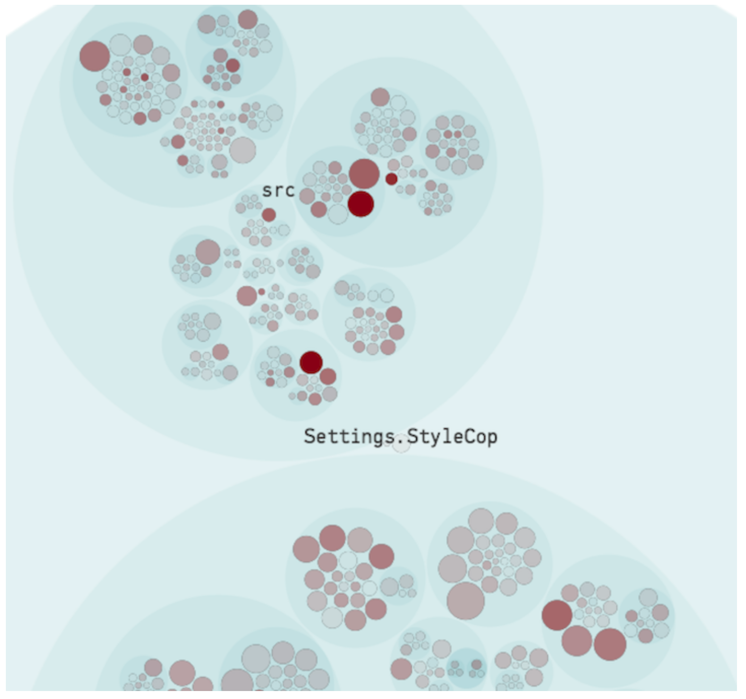
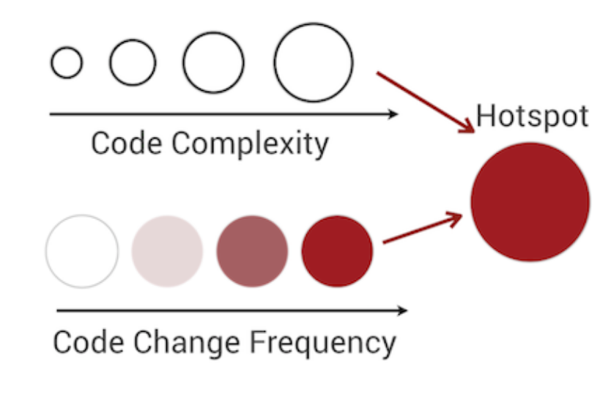

Slide 29
How do we obtain this information?

Slide 30
Version Control History

Slide 31
We normally think of it as an insurance policy

Slide 32
It is a data mine

Slide 33
Can answer a number of questions:

Slide 34
Version Control History
Who modified a file?
Can generate knowledge & ownership maps

Slide 35
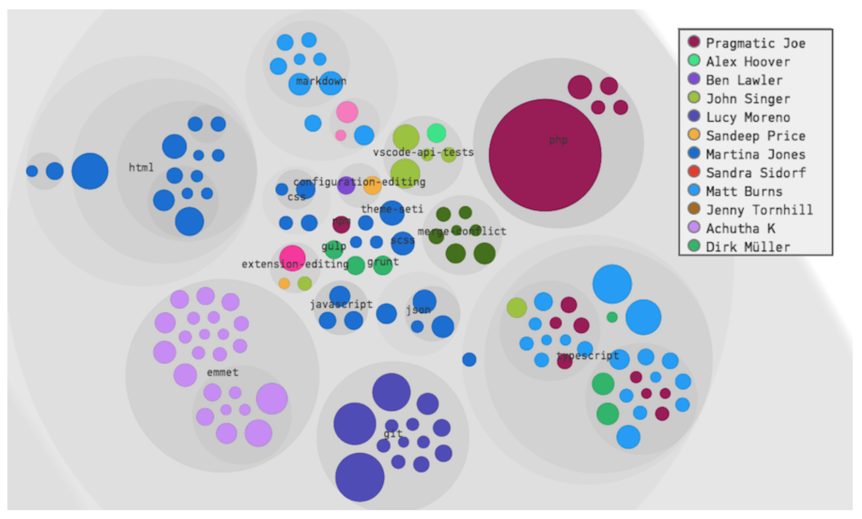

Slide 36
Version Control History
How long ago was a file last modified?
Code age
We want code to be very new or very old
Ebbinghaus forgetting curve

Slide 37
Version Control History
How frequently is a file modified?
Code stability & responsibility issues
Common cause - low cohesion

Slide 38
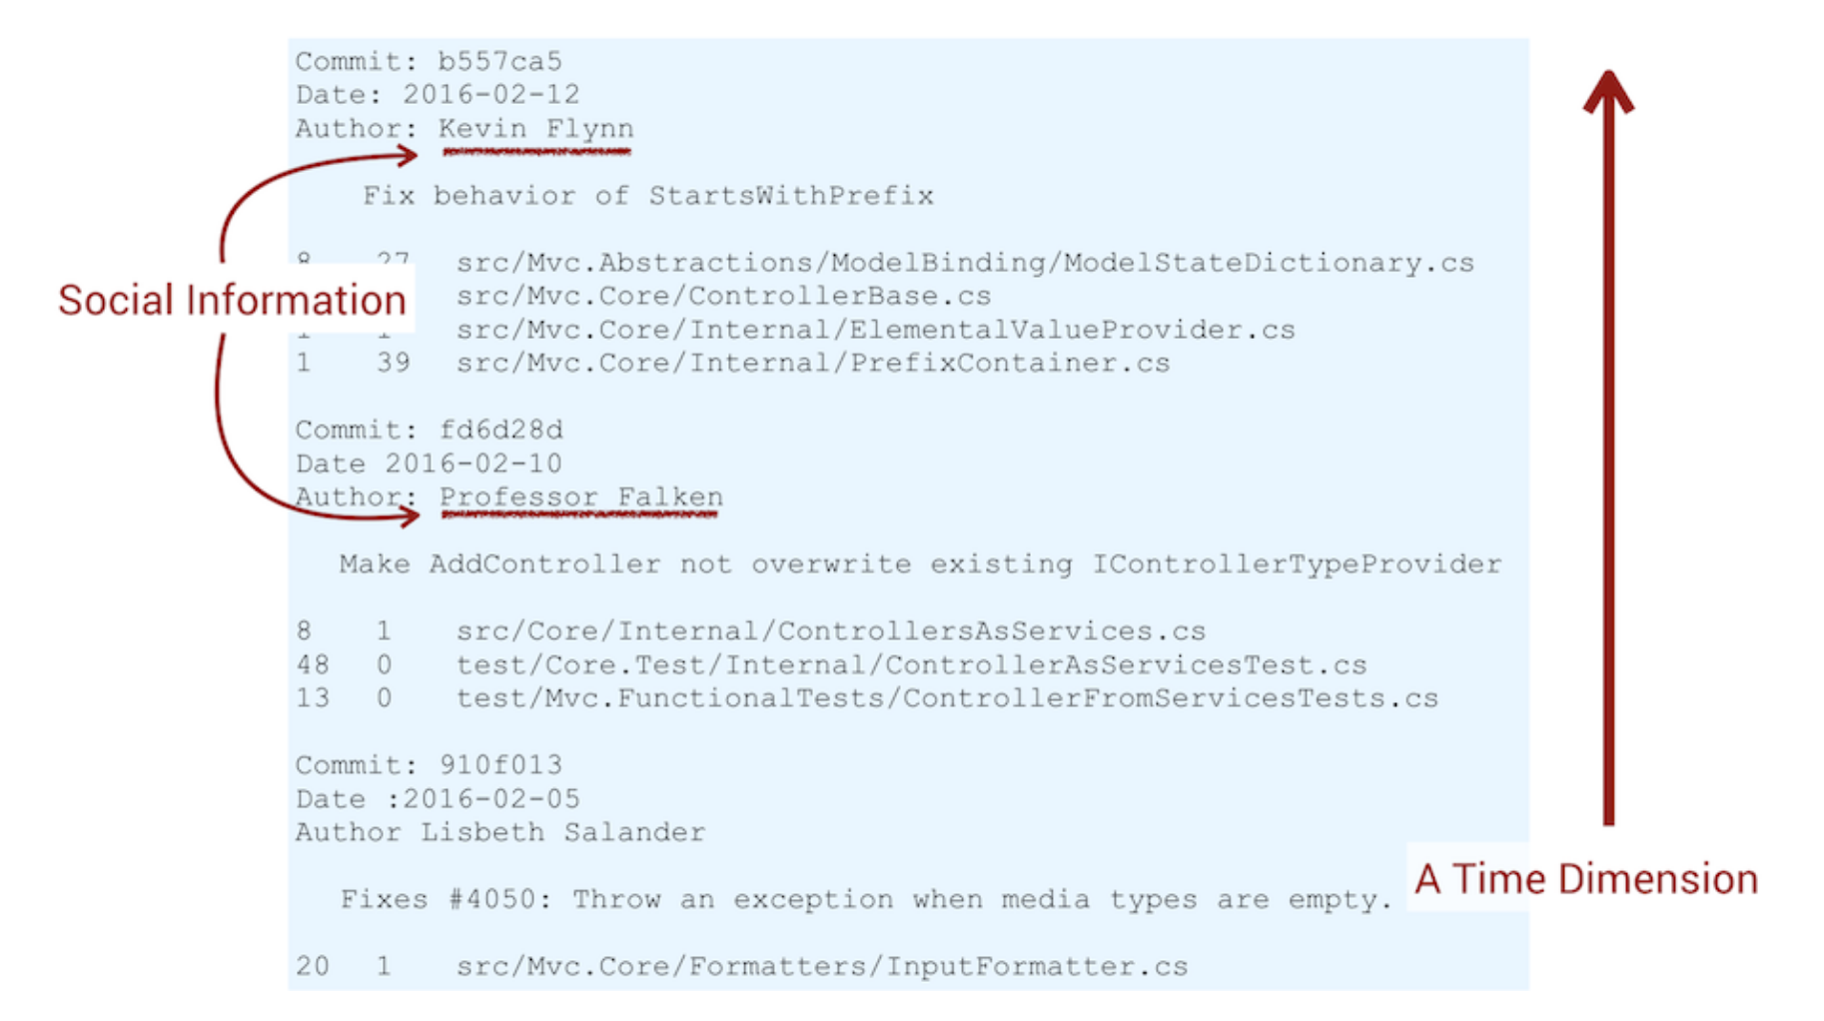

Slide 39
Tools

Slide 40
codescene.io
https://codescene.io/
Cloud & On-premise options
Demo - https://codescene.io/projects/177/jobs/11548/results

Slide 41
code-forensics
https://github.com/smontanari/code-forensics

Slide 42
code-forensics demo

Slide 43
We’ve found *where* the tech debt is, but not *what* it is

Slide 44
Strategies for Addressing Tech Debt

Slide 45


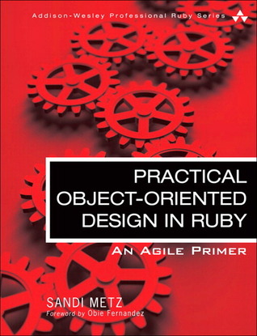

Slide 46
Step 0: Add pinning/characterization tests as a safety net

Slide 47
Therapeutic Refactoring by Katrina Owen https://www.youtube.com/watch?v=KA9i5IGS-oU

Slide 48
SOLID Principles

Slide 49
SOLID Principles

Slide 50
Single Responsibility Principle
“Every module, class, or function should have responsibility over a single part of the functionality provided by the software, and that responsibility should be entirely encapsulated by the class.”

Slide 51
Single Responsibility Principle
A class should only have one reason to change

Slide 52
Low Cohesion
Cohesion - the degree to which the elements inside a module belong together
The more the methods work toward a unifying purpose -> high cohesion
The more the methods are unrelated -> low cohesion
More responsibilities -> more reasons to change

Slide 53
Low Cohesion
Can manifest as:
Large classes/modules
Long methods
Lots of methods in one class/module doing various things

Slide 54
Make small classes that do one thing

Slide 55
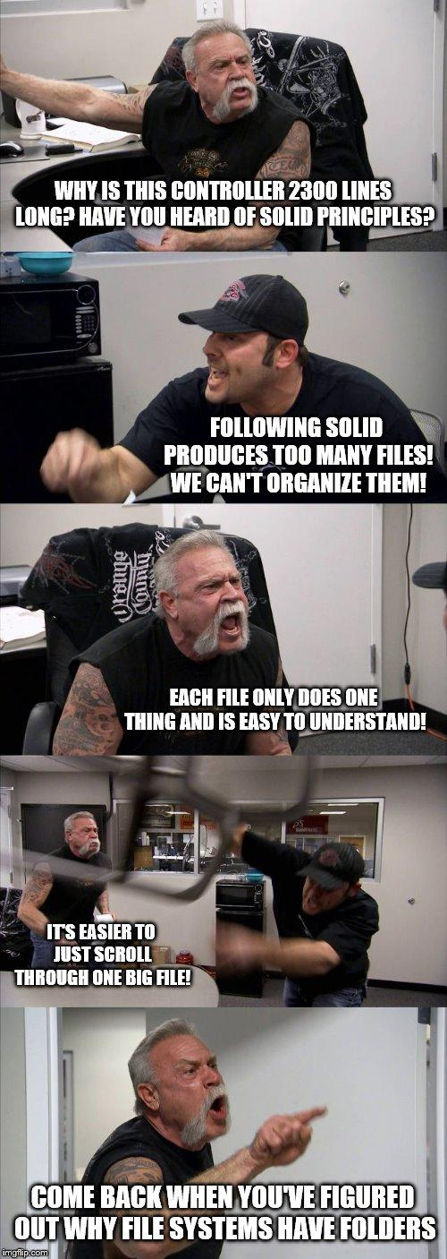

Slide 56
Make small functions

Slide 57
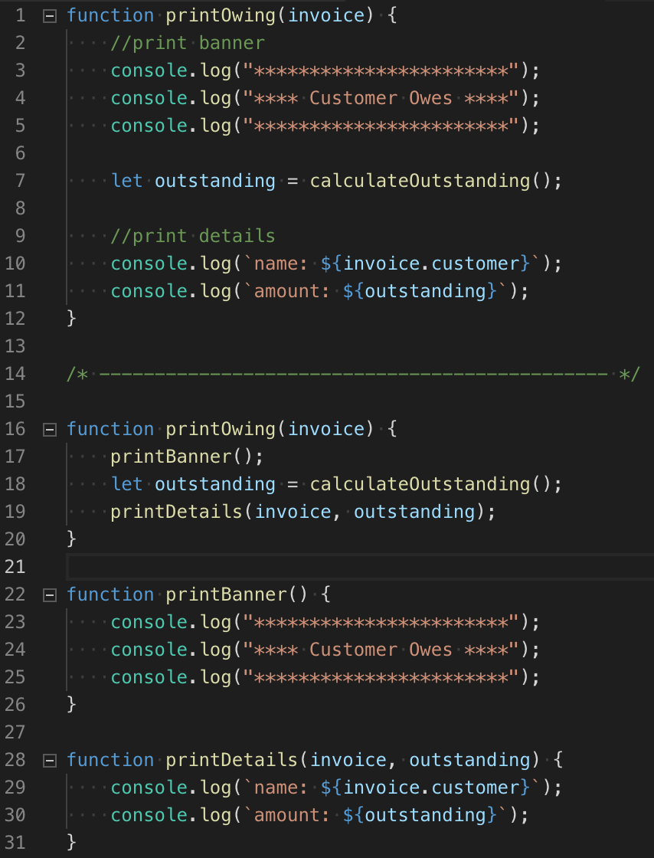

Slide 58
Use triggers to prompt thinking about breaking code down into smaller pieces

Slide 59
If a class is over 100 lines code, ask:
Can I split this class up into multiple smaller classes?

Slide 60
If a method has over 4 parameters, ask:
Can I extract some or all of these parameters into an object?

Slide 61
If a method is over 10 lines of code, ask:
Can I split this method up into multiple smaller ones?

Slide 62
These are not dogmatic rules to always follow

Slide 63
Automated refactorings
are your friend
Extract function/method
Extract class
Rename variable/function/class

Slide 64
One last thing

Slide 65
The highest priority tech debt is the code you’re currently working in

Slide 66
Further Reading

Slide 69
Questions / Comments

Slide 70
Thank you

